Slide 1
Online Store System
UML diagrams MPP Project

Slide 2
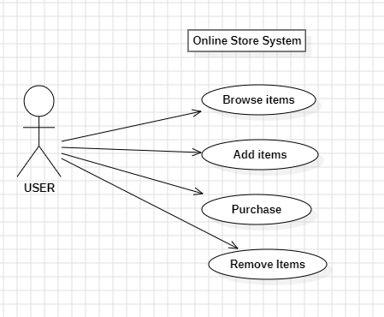
Use Case Diagram for The Online-store System

Slide 3
Class Diagram Of Online Store System

Slide 4
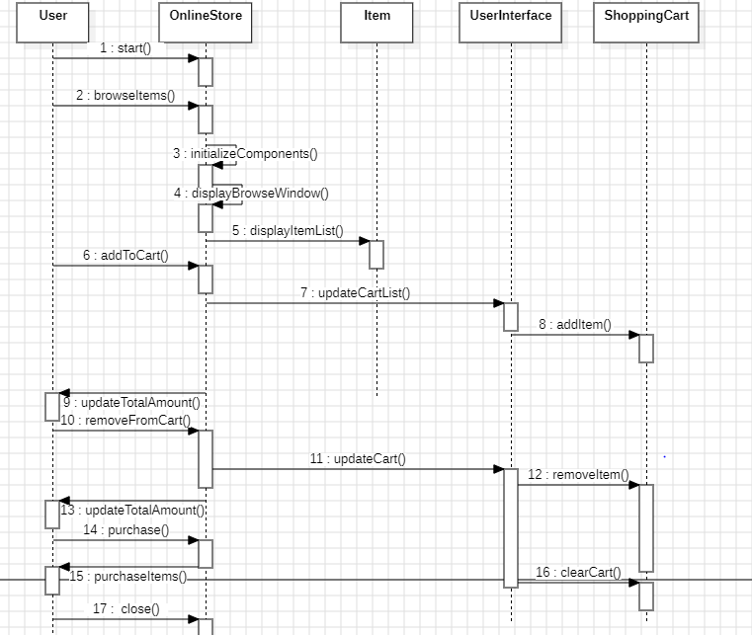
Sequence Diagram Of The Online Store System

